Slide 1

Quantum Information and Computing
2021 - 2022
Saverio Monaco
06/12/21
Exercise 5
Split-Operator Application in a Time
Dependent Hamiltonian

Slide 2
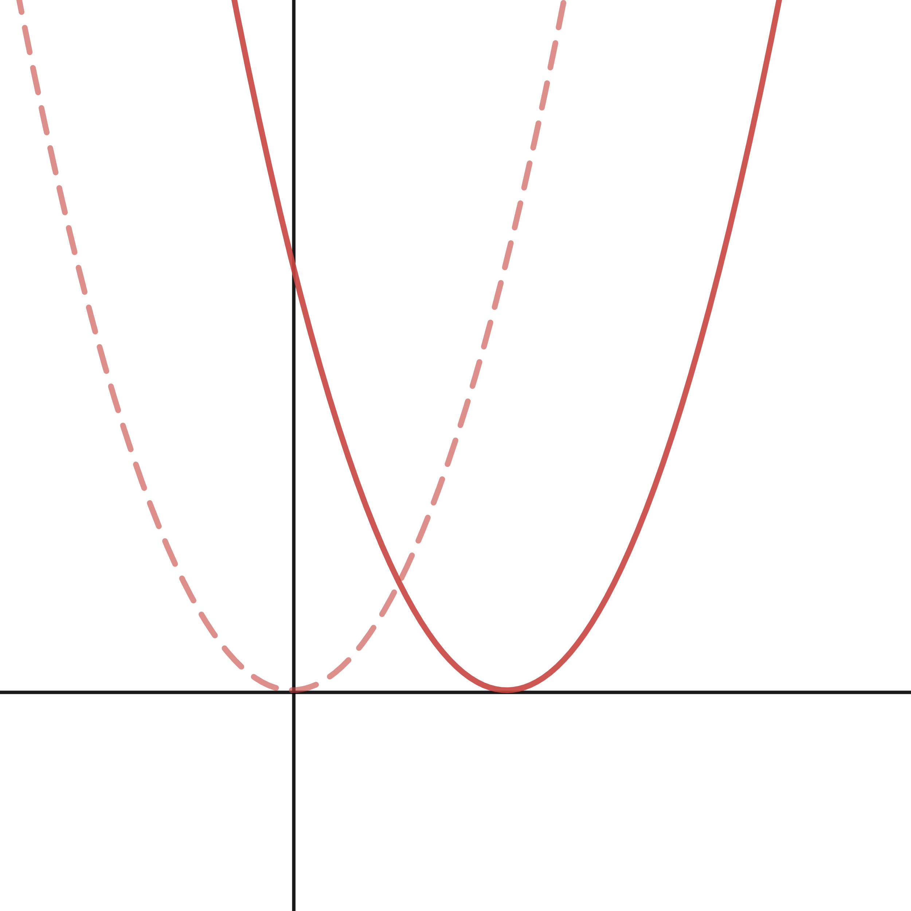
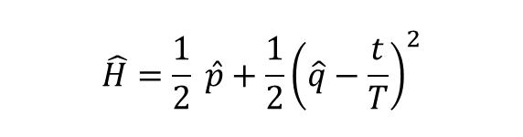
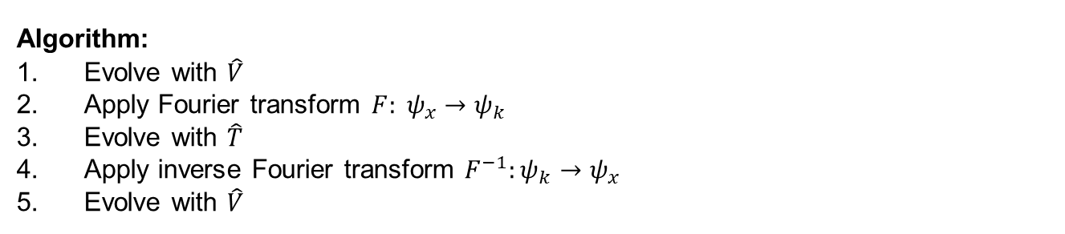
Theory
$$\hat{H}=\frac{1}{2} \hat{p}+\frac{1}{2}{\left(\hat{q}−\frac{t}{T}\right)}^{2}$$
Algorithm:
Evolve with $\hat{V}$
Apply Fourier transform ${F: ψ}_{x}→ψ_{k}$
Evolve with $\hat{T}$
Apply inverse Fourier transform $F^{−1}:ψ_{k}→ψ_{x}$
Evolve with $\hat{V}$
Notes:
Explain very briefly the theory you have based your solution on

Slide 3
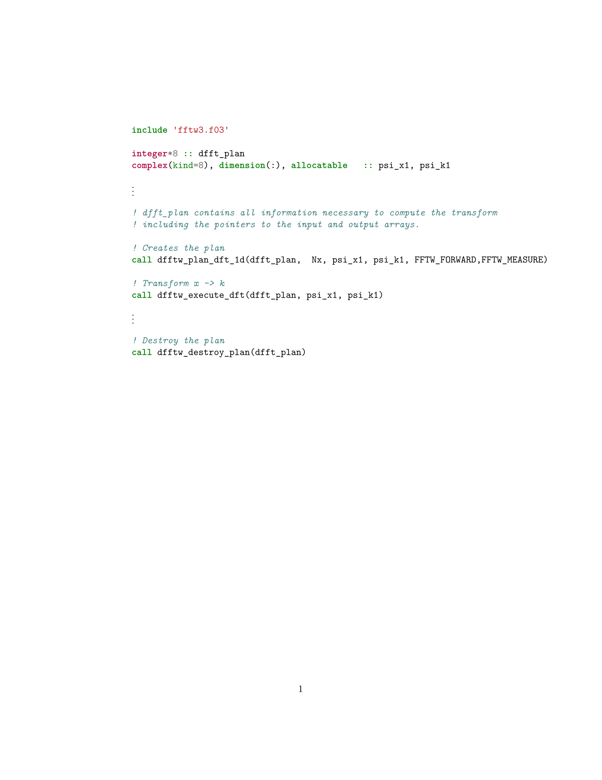
Code Development
To compile it:
gfortran time_dep_qho.f03 -o tqho -Wall -llapack -lfftw3 -frecursive
Notes:
Explain very briefly the theory you have based your solution on

Slide 4
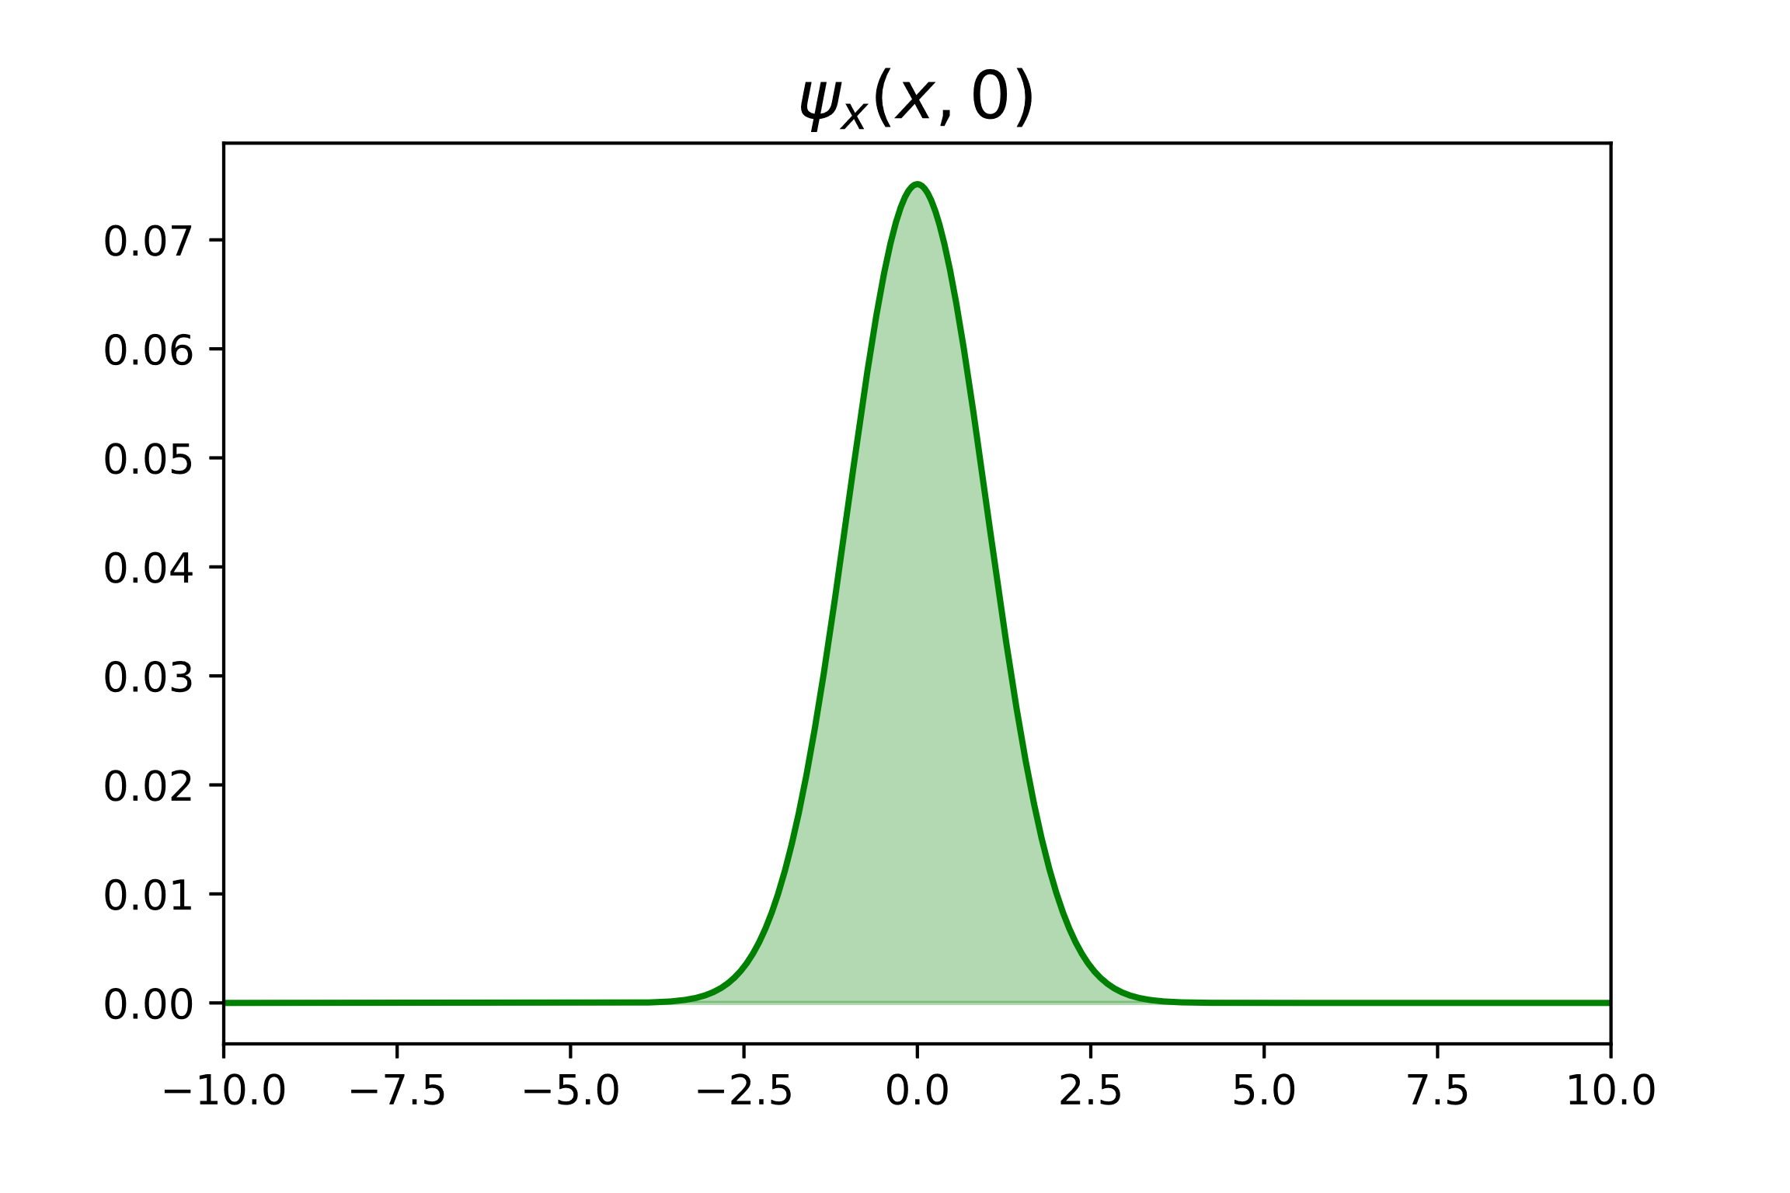

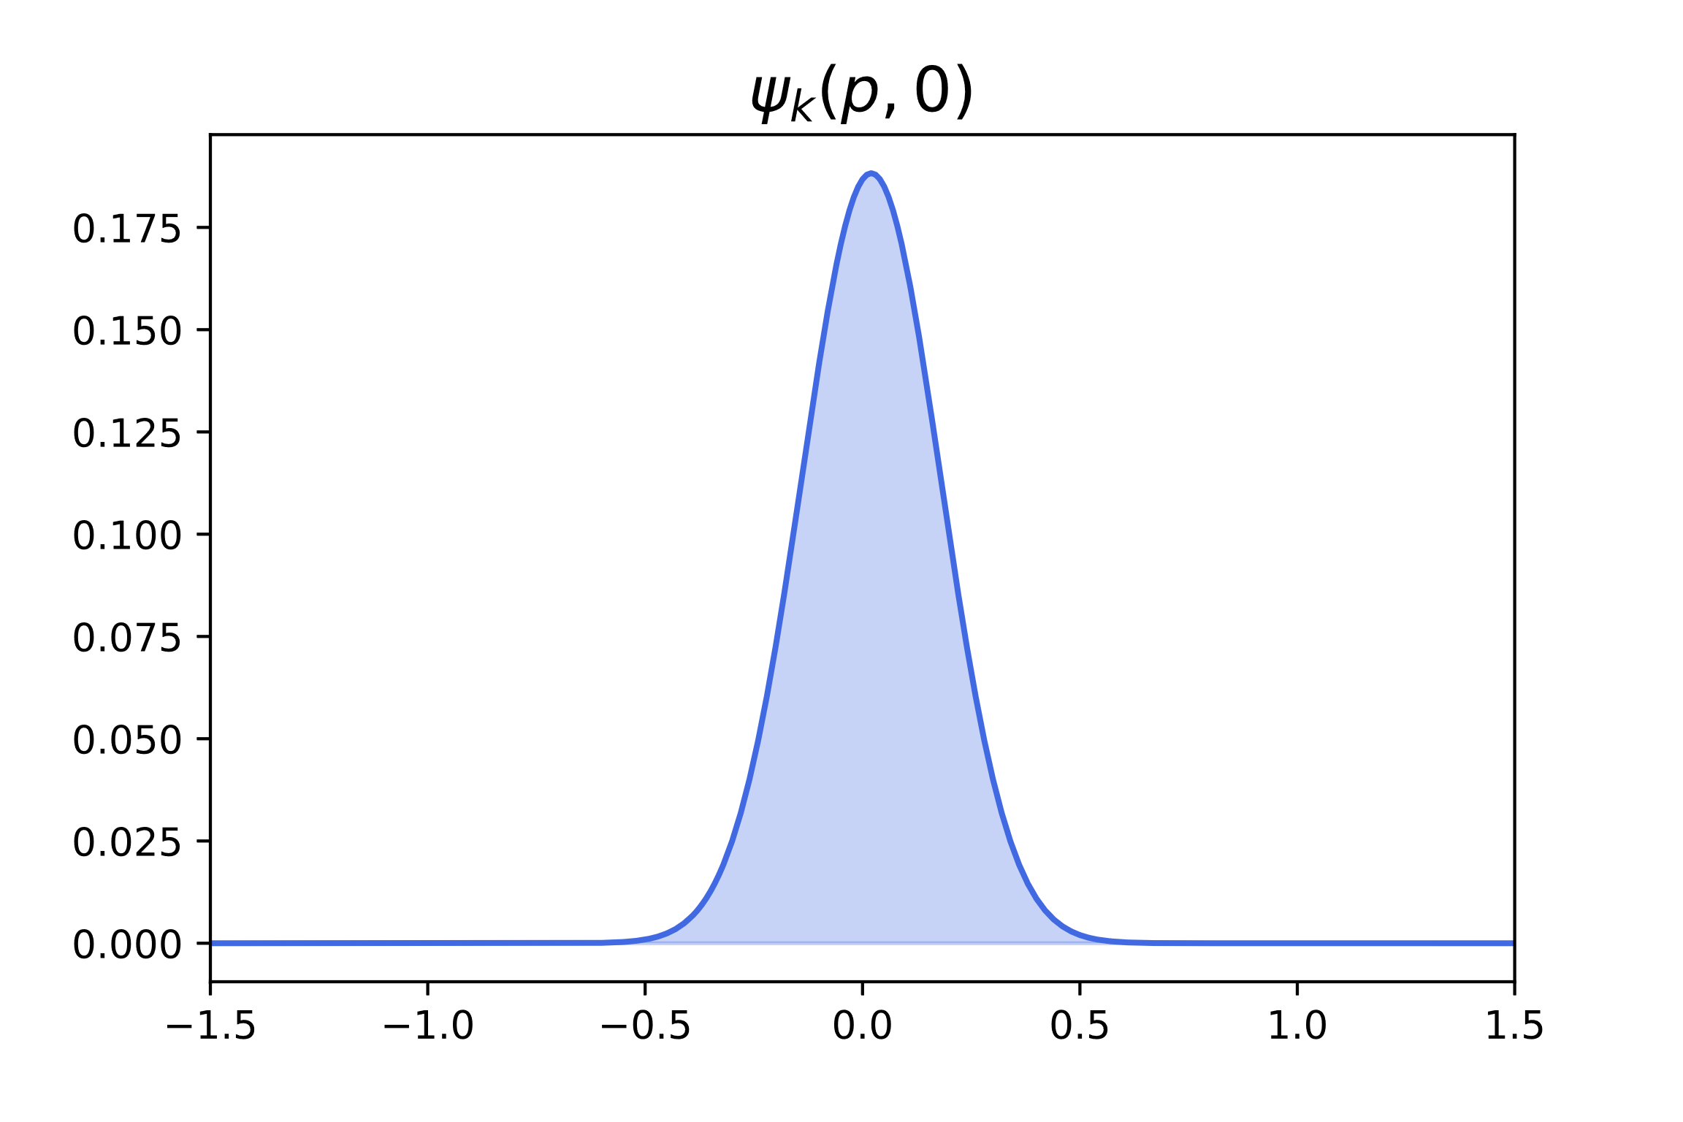
Code Development
Notes:
Explain very briefly the theory you have based your solution on

Slide 5
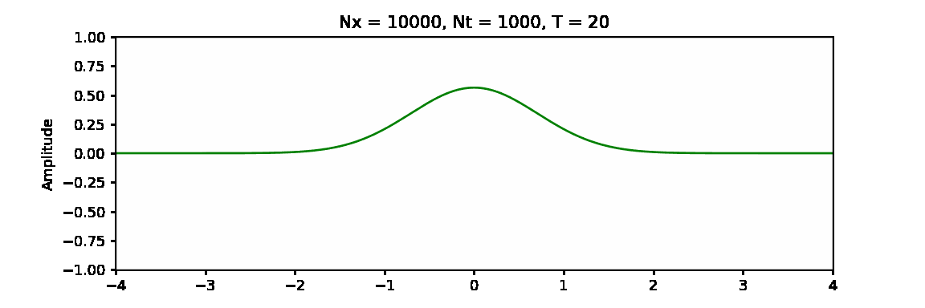
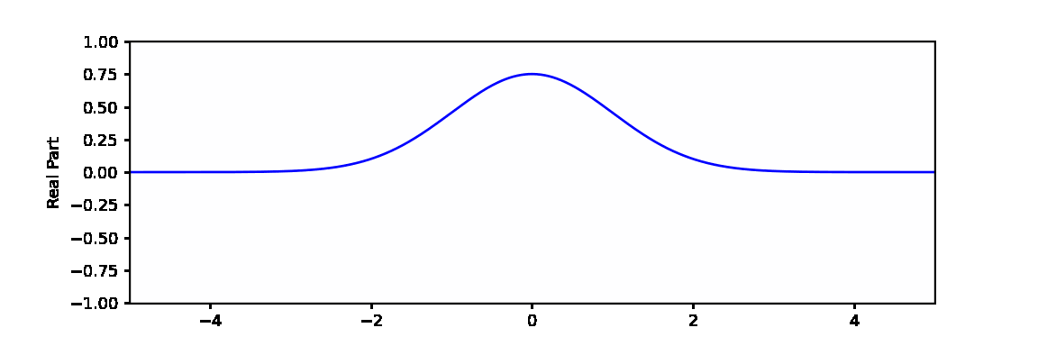
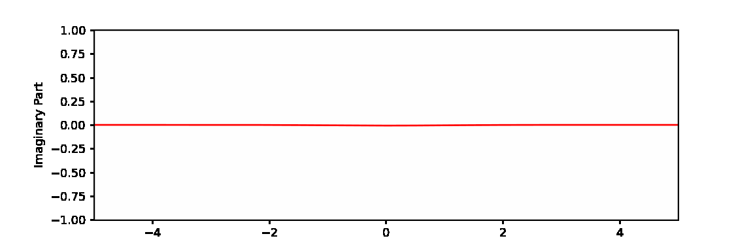
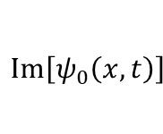
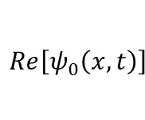
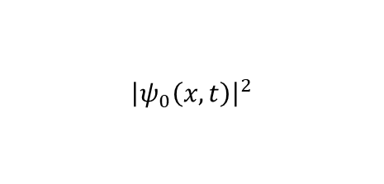
Results
$${\left|ψ_{0}\left(x,t\right)\right|}^{2}$$
$$Re\left[ψ_{0}\left(x,t\right)\right]$$
$$Im\left[ψ_{0}\left(x,t\right)\right]$$
Notes:
Explain very briefly the theory you have based your solution on

Slide 6
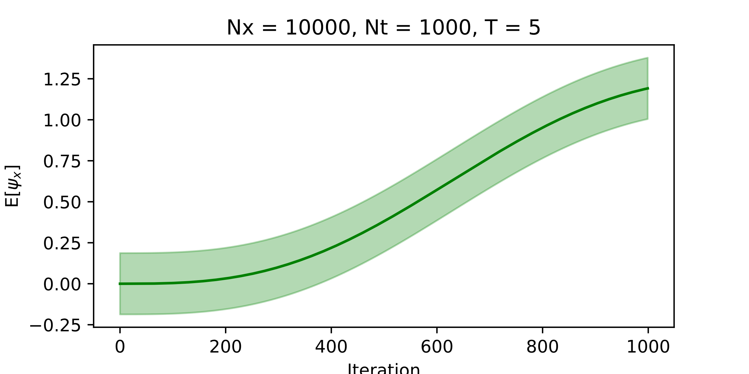
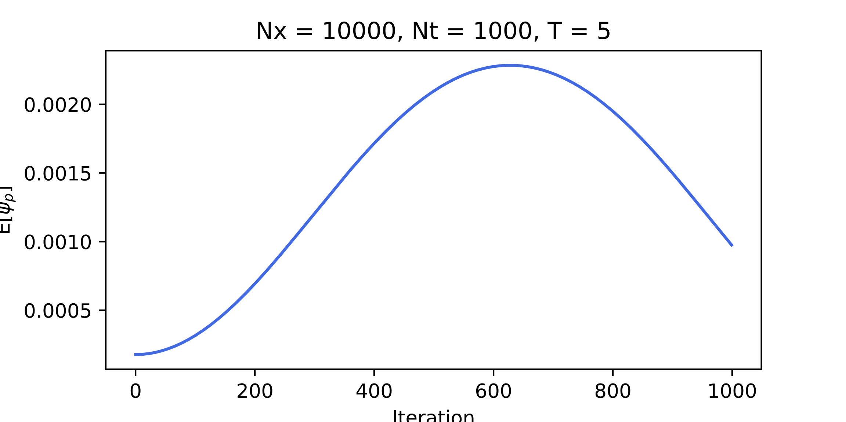
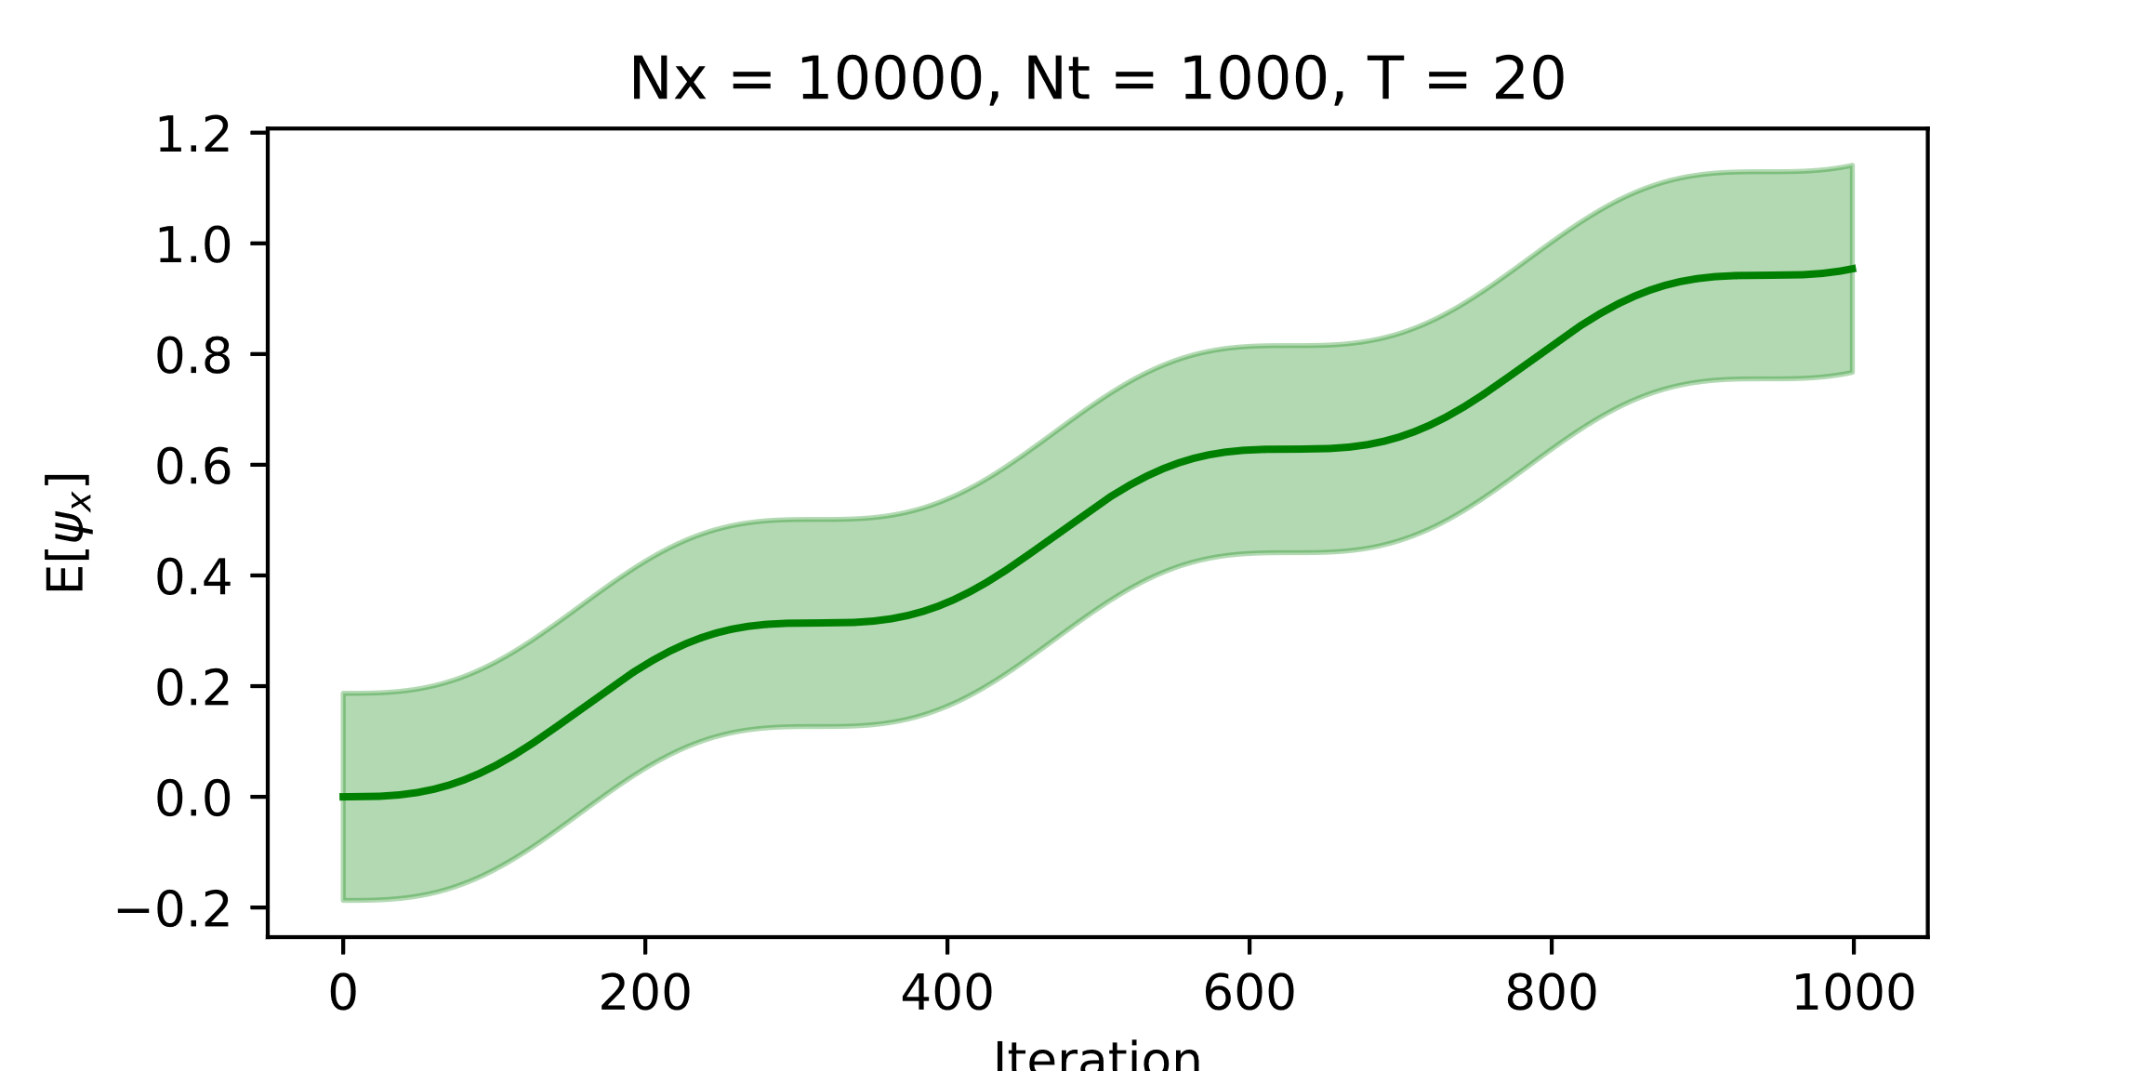
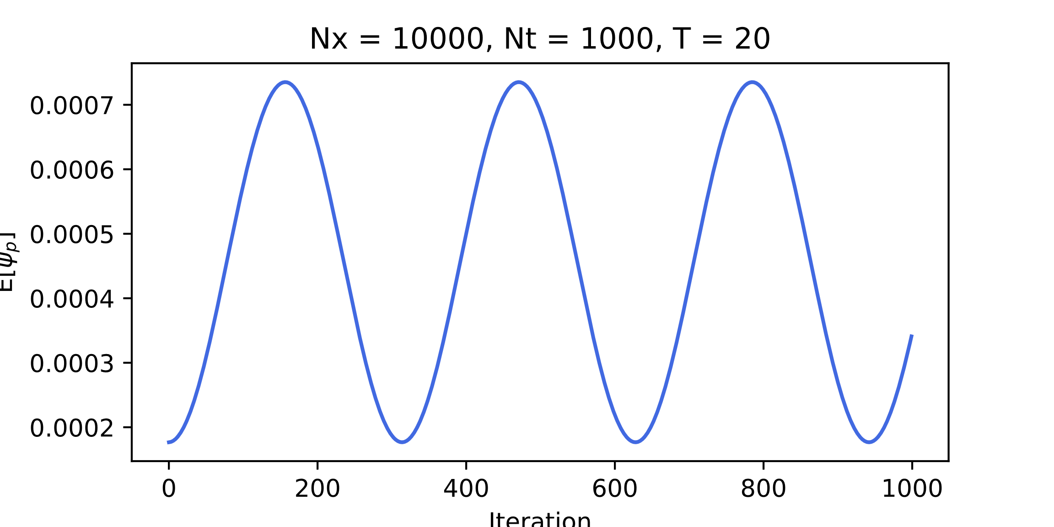
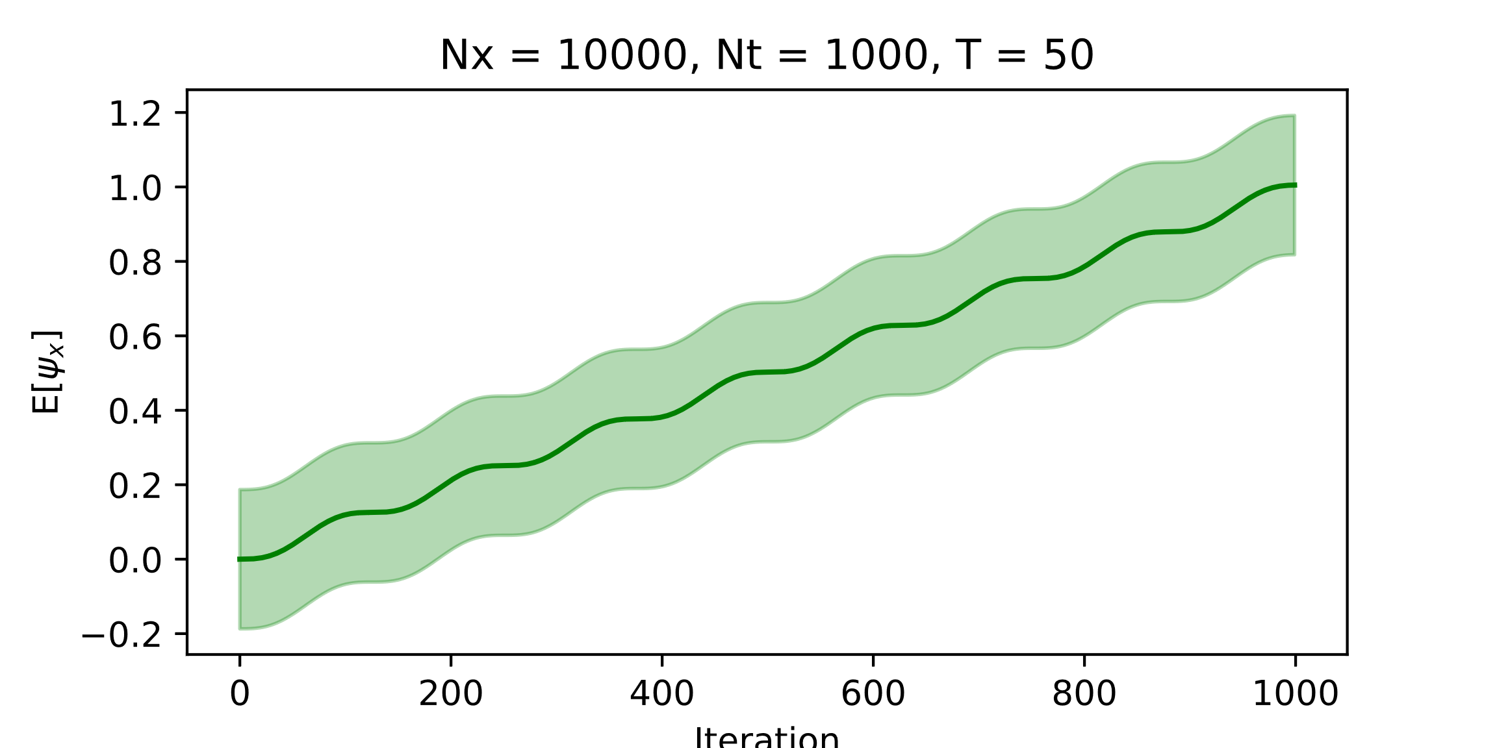
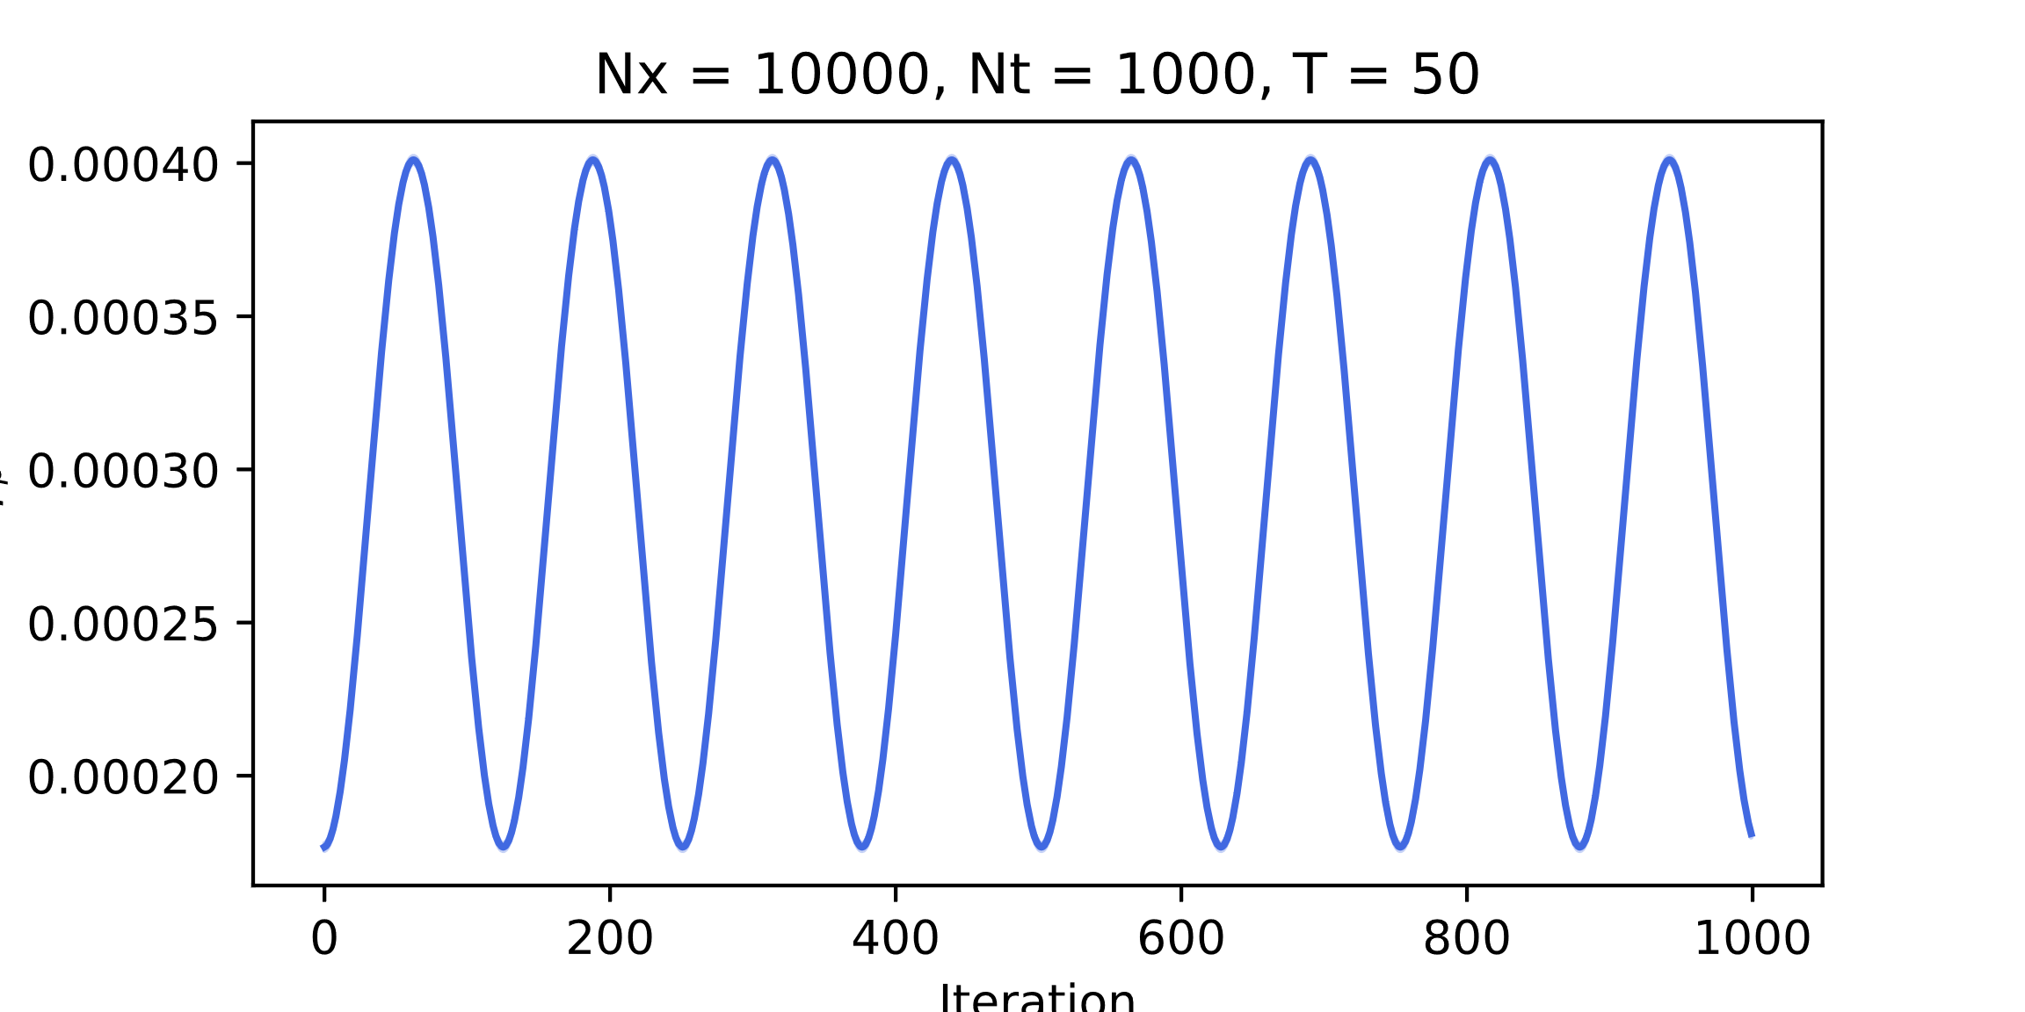
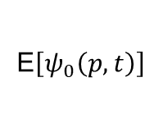
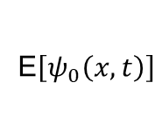
Results
E$\left[ψ_{0}\left(x,t\right)\right]$
E$\left[ψ_{0}\left(p,t\right)\right]$
Notes:
Explain very briefly the theory you have based your solution on

Slide 7
Thanks for the attention
___________________________

